Slide 1
Cache Memory
Abdul Haseeb

Slide 2
Objectives
After studying this chapter, you should be able to:
Present an overview of the main characteristics of computer memory systems and the use of a memory hierarchy.
Describe the basic concepts and intent of cache memory.
Discuss the key elements of cache design.
Distinguish among direct mapping, associative mapping, and set-associative mapping.
Explain the reasons for using multiple levels of cache. Understand the performance implications of multiple levels of memory.

Slide 3
4.1 Computer Memory System Overview

Slide 4
What is memory!
Electronic holding/storage space:
To store information (data and instructions) for immediate use in computers.

Slide 5
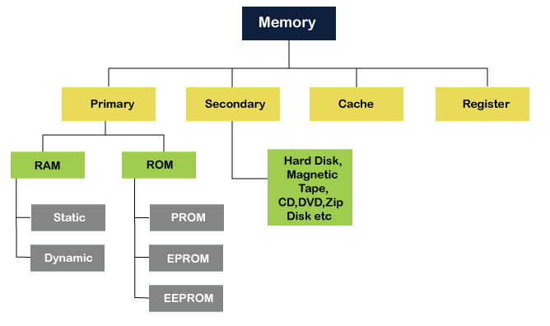
Classification of Memory

Slide 6
Characteristics of Computer Memory
Location:
Whether memory is external or internal
Internal:
Local to the processor
Normally concerned with RAM
But there are other types too
External:
Peripheral storage Devices, like?

Slide 7
Characteristics of Computer Memory
Capacity:
Amount of data a memory can hold
Bit is the basic unit (0 or 1)
Byte is the smallest possible unit for storage (byte)
Internal memory Capacity:
expressed in bytes (8 bits) or words which are normally 8,16 and 32 bits
External memory capacity is expressed in bytes

Slide 8
Characteristics of Computer Memory
Unit of Transfer:
Number of electrical lines in and out of the memory
Normally it is equal to length of a word, but can be often larger than a word such as 64,128, 256:
Data can be transferred in block of words

Slide 9
Characteristics of Computer Memory
Methods of Access:
Sequential
Random
Direct

Slide 10
Characteristics of Computer Memory
Sequential Access:
When ever an access request is made:
Memory is searched linearly in sequential fashion
Search is started from the first memory location
Incremented by moving one step ahead at a time, until desired location is found
Simple but slow technique
A
B
C
D
F
G
H

Slide 11
Characteristics of Computer Memory
Random Access:
Data present at any location can be accessed directly
Time to access any memory location is same
Faster way to retrieve the data
RAM
A
B
C
D
F
G
H

Slide 12
Characteristics of Computer Memory
Block 1
A
B
C
D
Direct Access:
Memory divided into blocks (multiple memory locations),used by magnetic and optical discs
Like Random access:
Blocks can be accessed randomly, so block access time is same
Unlike Random Access:
But time taken to access a memory location A is different as compared to accessing a memory location J:
Sequential access inside the blocks
Block 2
E
F
G
Block 3
H
I
J

Slide 13
Characteristics of Computer Memory
Performance:
Very important for user
Parameters for performance:
Access Time (latency)
Memory cycle time
Transfer Rate

Slide 14
Characteristics of Computer Memory
Access Time:
For Random Access Memory:
Time taken for a read or write operation
Time from the instant that an address is presented to the time instant the data is stored or made available for use
For Non-Random Access Memory:
Time to position read-write mechanism at desired location

Slide 15
Characteristics of Computer Memory
Memory Cycle Time:
Access Time+ Wait time (regenerate signals)
Transfer Rate:
The rate at which data is transferred in/out of the memory
For Random-access memory, it is: 1/(cycle time)

Slide 16
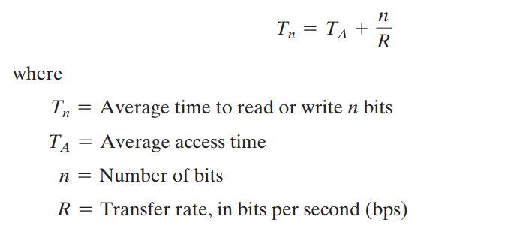
Characteristics of Computer Memory
Transfer Rate for Non-Random Access Memory:

Slide 17
Problem
Find out the time taken for write operation to take place in RAM, when memory cycle time is 5 seconds
Find out the Transfer Rate for a Solid State Drive, when unit to read is 16 bits, average access time is 0.001 seconds, and average time to read n bits is 5 seconds

Slide 18
Characteristics of Computer Memory
Physical Types:
Memory can be:
Semiconductor
Magnetic
Optical

Slide 19
Characteristics of Computer Memory
Physical Characteristics:
Memory can be:
Volatile/Non Volatile
Erasable/Non Erasable

Slide 20
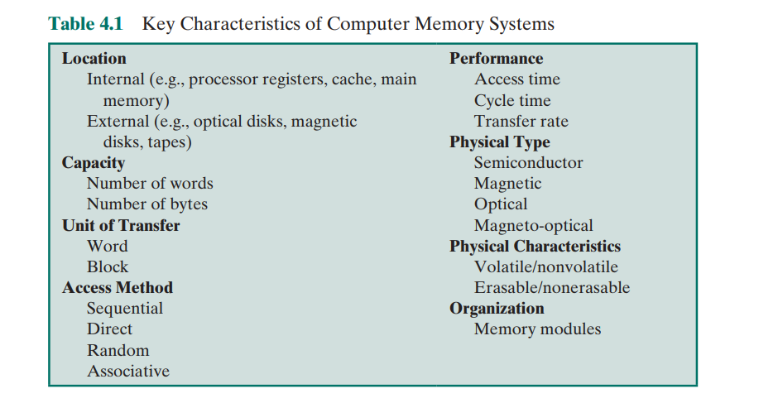
Summary

Slide 21
The Memory Hierarchy
Design constraints on Computer’s memory:
How Much?
According to applications demand
How Fast?
Keep up with the processor, so that processor isn’t idle
How Expensive?
Lets understand it

Slide 22
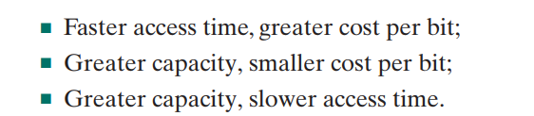
The Memory Hierarchy
How Expensive?

Slide 23
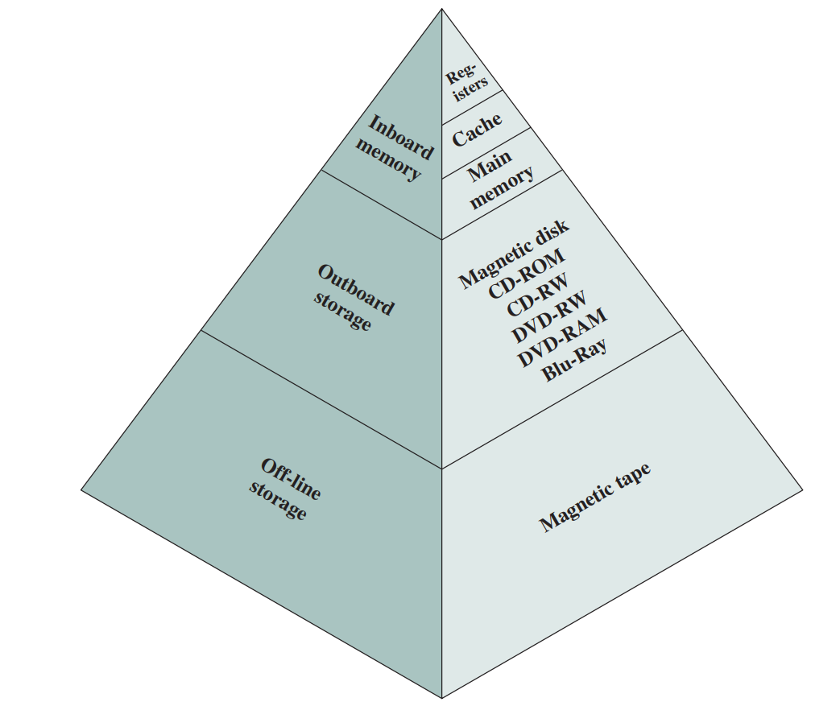
The Memory Hierarchy
Way out of this problem is to employ a memory
hierarchy

Slide 24
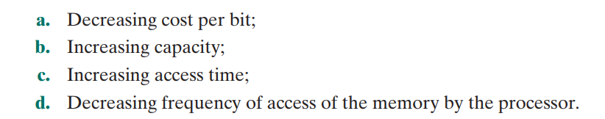
The Memory Hierarchy
As one goes down the hierarchy

Slide 25
Hit and Miss
Hit:
If the accessed word is found
Miss:
If the accessed word is not found

Slide 26
Principle of Locality of reference
A processor executes a program:
A program has arrays, loops etc
Inside a loop there are instructions which repeat
Same reference is used for a particular period of time

Slide 27
Principle of Locality of reference
Principle of locality of reference is the:
Tendency of a processor to access the same set of memory locations repetitively over a short period of time
It makes sure frequently accessed instructions are in faster memory
Improves the hit ratio

Slide 28
4.2 Cache Memory Principles

Slide 29
Cache Memory
It combines the benefits of both:
Memory access time of high speed memory (cache itself)
Large memory size of less expensive, lower speed memory (main memory)

Slide 30
What happens when a processor wants to read a word from memory!
Check is made in the cache
If available:
Word is delivered to the processor
If not available:
A Block of words is read from the memory, and the required word is delivered
But Why Block, Why not a single word:
Principle of locality of reference: Same word could be referenced again, or a word adjacent to the current word may be referenced

Slide 31
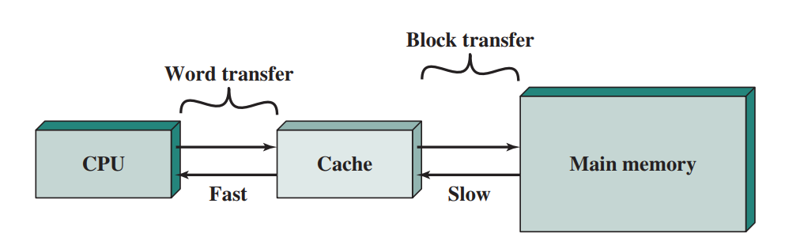
Cache memory

Slide 32
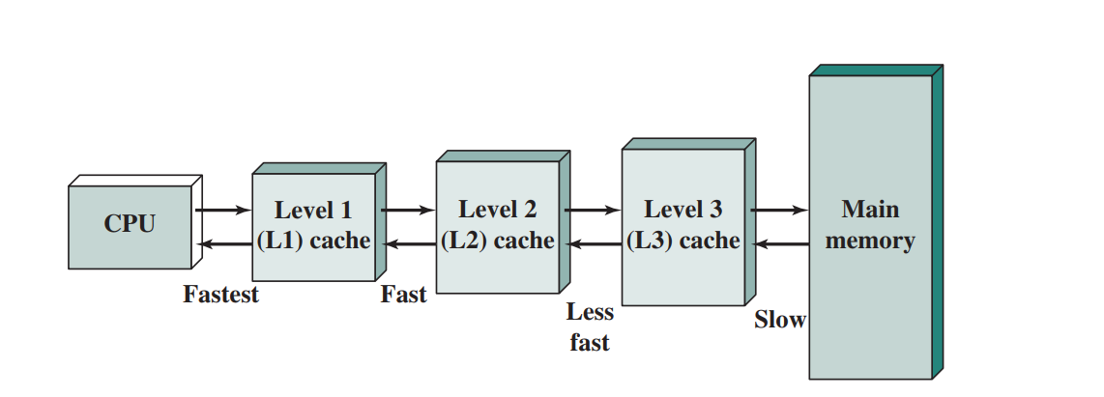
Levels of Cache

Slide 33
Structure of Main Memory System
N is the length of each word in bits, so total 2^{n} -1 words can be addressed
Further organization can be converted to blocks:
Where each block may contain K Words

Slide 34
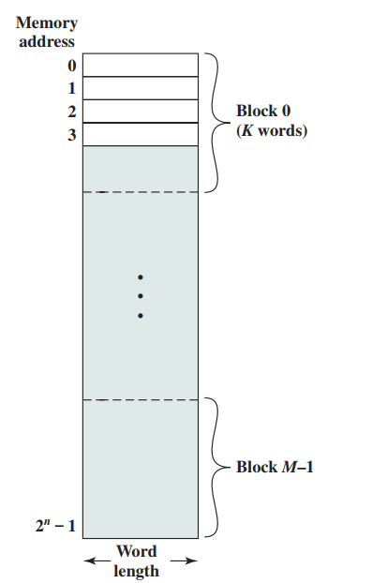

Slide 35
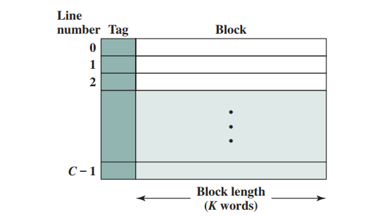
Structure of Cache System
Cache consists of m blocks called LINES, each line may contain K Words

Slide 36
Structure of Cache System
Cache consists of m blocks called LINES, each line may contain K Words, plus a tag

Slide 37
Structure of Cache
Each LINE may also include some control bits:
To show whether the line has been modified since the data is loaded into it
Line Size:
length of line, excluding the control and tag bits
Line size may be as small as 32 bits (4 words, each of one byte)

Slide 38
Structure of Cache
Understanding the Tag:
Number of lines in cache is smaller than the number of blocks in main memory m<M
We can not map one-one (one line to one block)
Tag is usually a memory address which identifies which block of memory is residing in a cache line

Slide 39
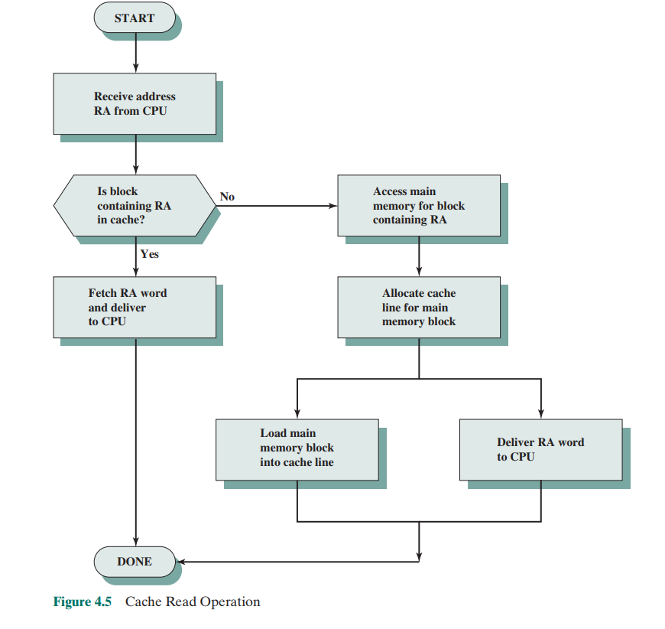

Slide 40
Contemporary Cache Structure
Cache connects to the processor via: data, address and control lines
Data and Address lines also attach to data and address buffers:
These in turn attach to system bus to reach the main memory

Slide 41
Contemporary Cache Structure
When a cache hit occurs:
Data and Address Buffers disabled
Communication between processor and cache
When a cache miss occurs:
Data is loaded from main memory on the data buffers available on system bus
Word transferred to cache and processor

Slide 42
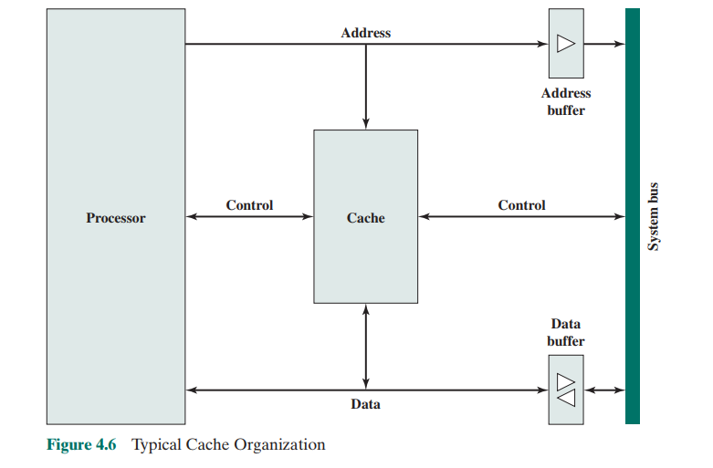

Slide 43
4.3 Elements of Cache Design

Slide 44
Elements of cache design
Cache Address:
Majority of Modern computers support virtual memory
With Virtual memory:
Address field contains virtual address
Then how to read/write to and from physical memory?
MMU a hardware component:
Translates each virtual address to physical address

Slide 45
Elements of cache design
Cache Address:
With virtual addresses:
Cache may be placed between processor and MMU or may be between Processor and Memory

Slide 46
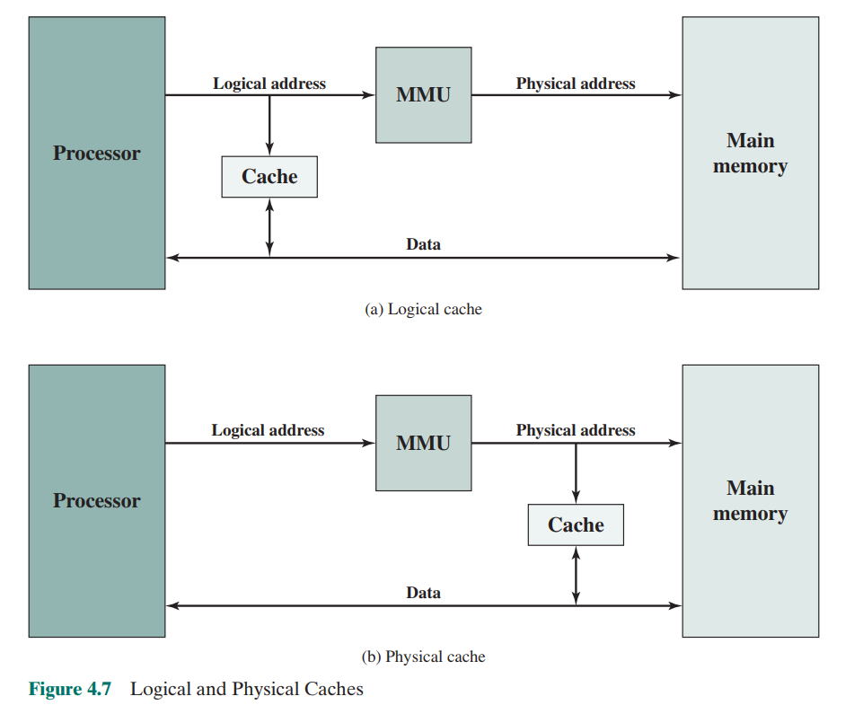

Slide 47
Elements of cache design
Logical cache (Virtual):
Stores data using virtual addresses
Directly accessed via processor
No need to go through MMU
Faster
Physical cache:
Stores data using physical addresses
slower

Slide 48
Elements of cache design
Cache Size:
Should be as minimum as possible
Larger the cache, larger the circuit, slower access time

Slide 49
Elements of cache design
Mapping Function:
Fewer cache lines than the memory blocks
An algorithm:
Needed for mapping cache lines to memory blocks
Also a means to determine:
which memory block currently occupies a cache line

Slide 50
Elements of cache design
Mapping Function:
Direct
Associative
Set Associative

Slide 51
Direct Memory Mapping
It is called Direct Memory mapping because:
All memory blocks are directly mapped onto the cache lines

Slide 52
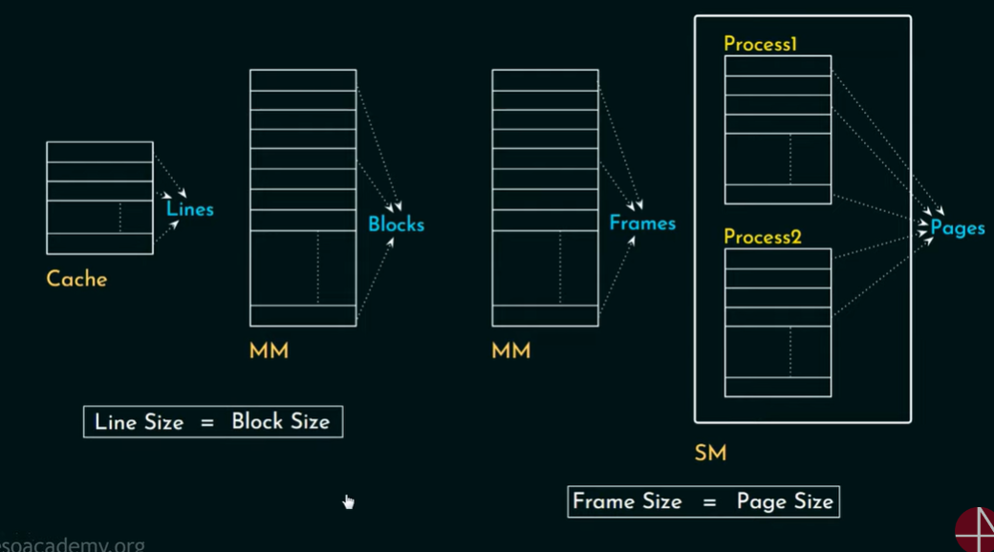

Slide 53
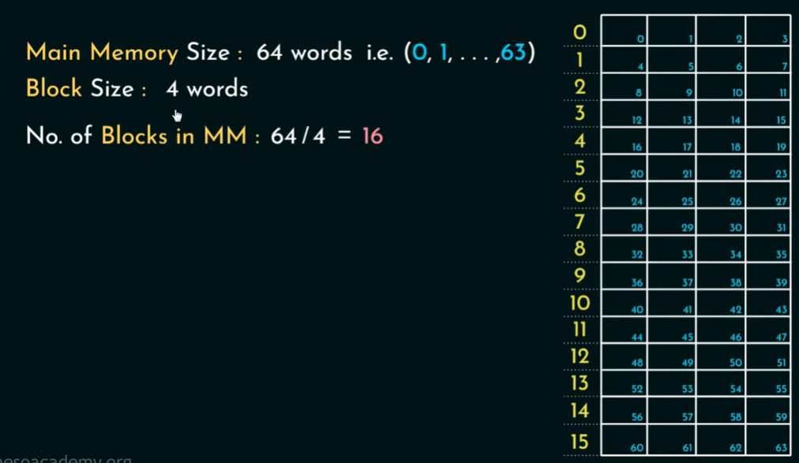

Slide 54
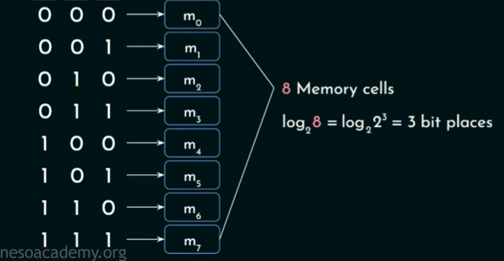

Slide 55
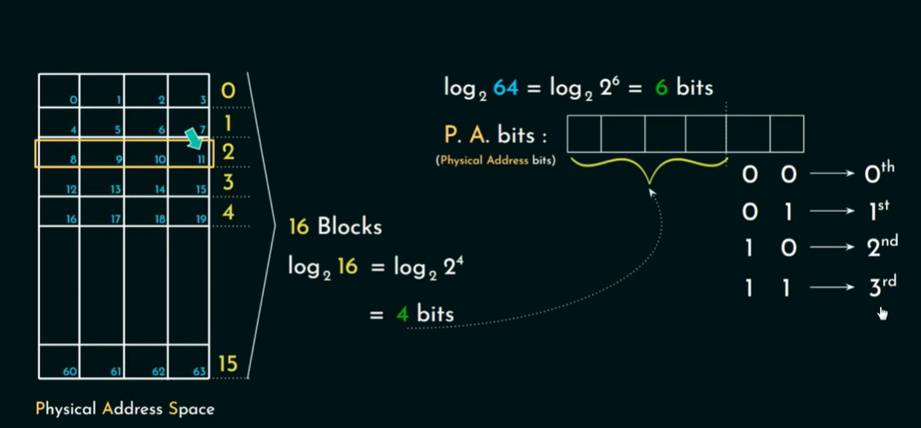

Slide 56
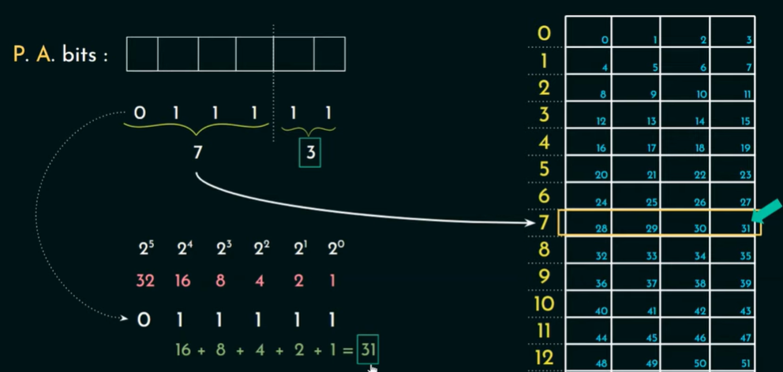

Slide 57
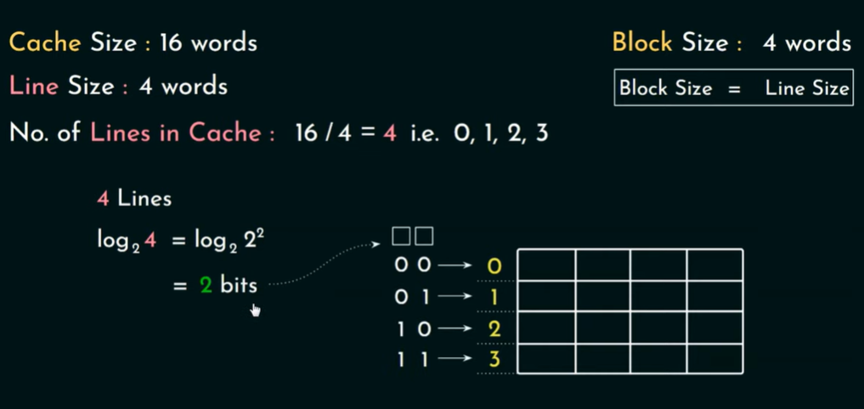

Slide 58
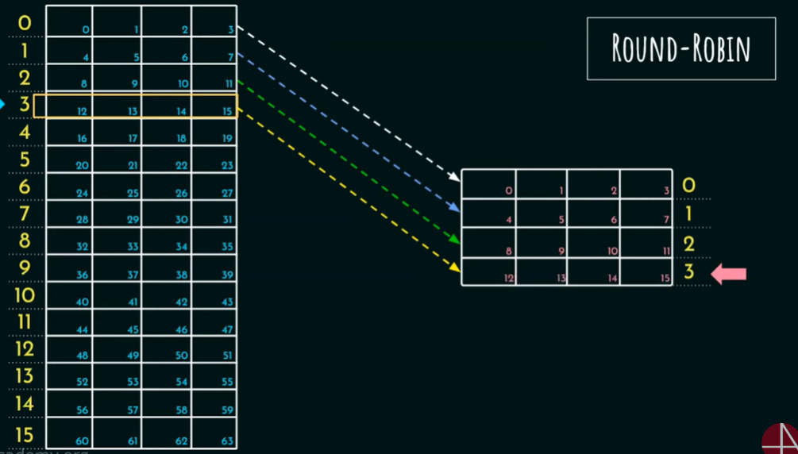

Slide 59
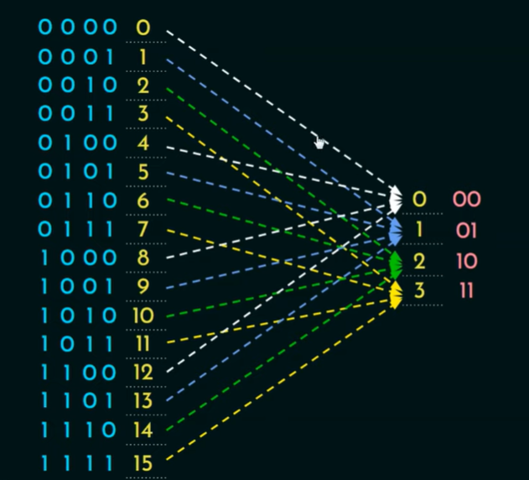

Slide 60
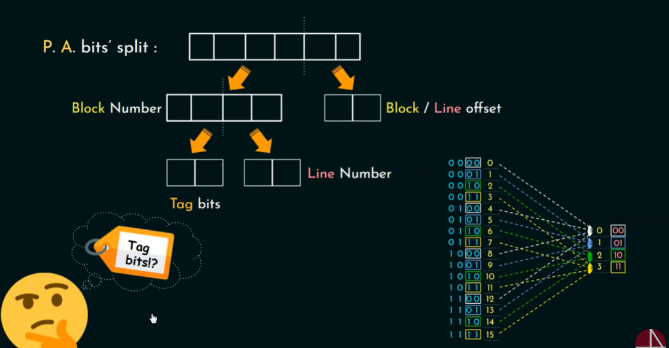

Slide 61
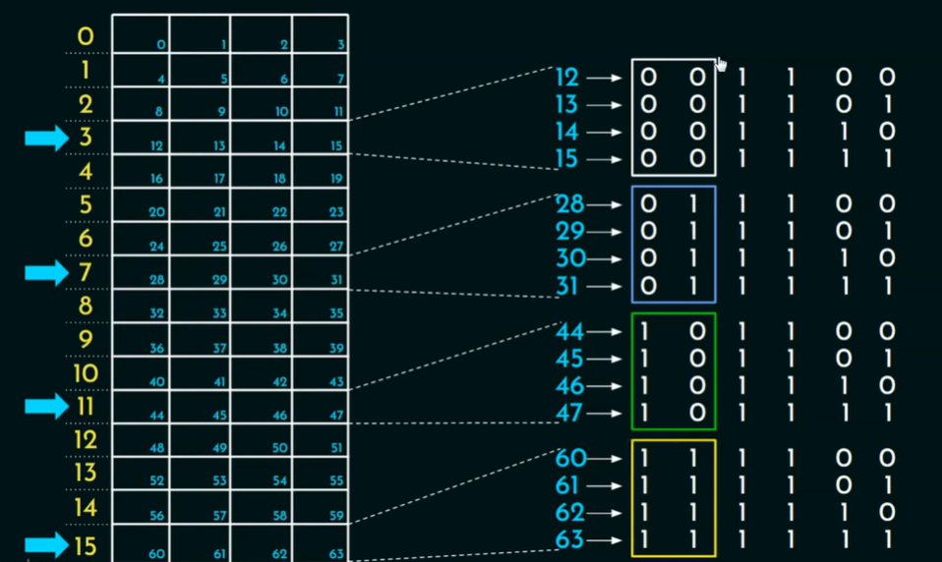

Slide 62
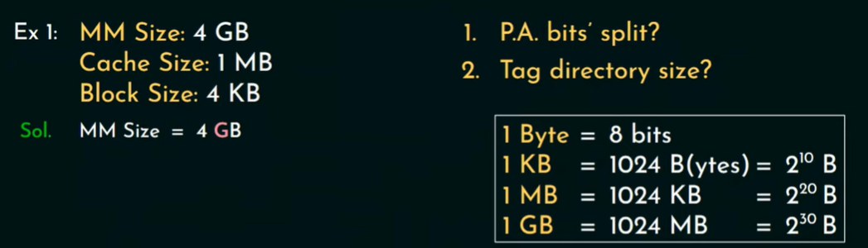

Slide 64
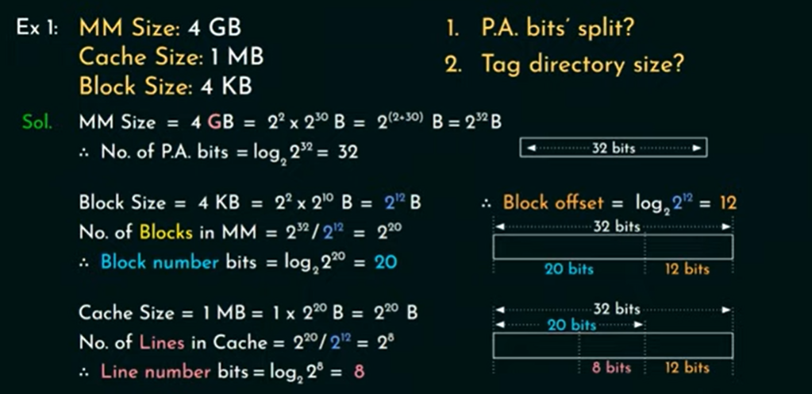

Slide 65
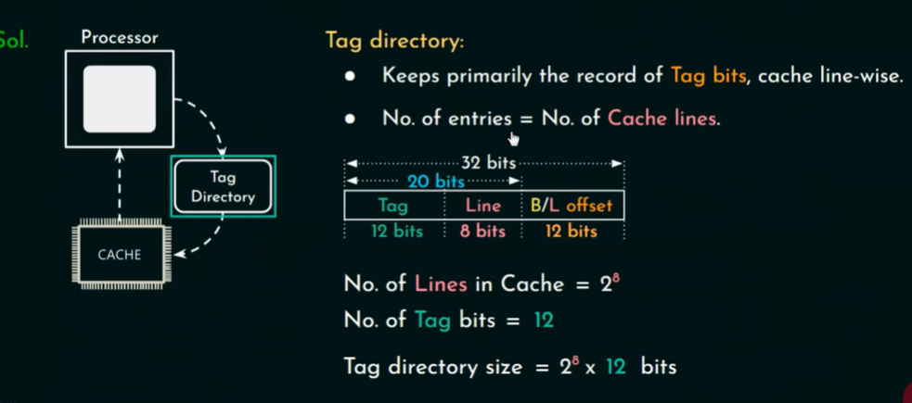

Slide 66
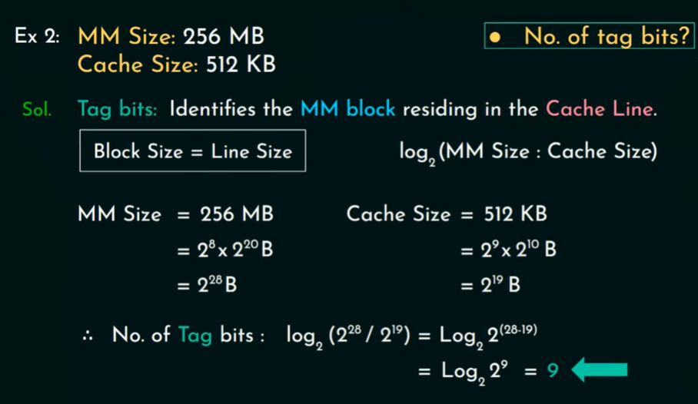

Slide 67
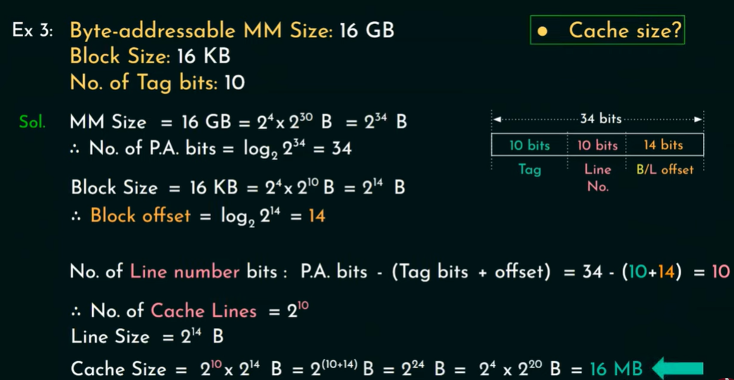

Slide 68
Direct Cache Mapping
It is very easy to implement
A single memory block may be mapped onto multiple cache lines:
Block data could be swapped again and again inside cache lines
This will lead to lower hit ratio, one line will find other will not, also known as conflict miss

Slide 69
Associative Mapping
With associative mapping:
Any block can be assigned to any of the cache lines
Therefore cache control logic is represented in only Tag, and block/line offset
No any line number is required
But this would cause:
Inability to determine which block is loaded in which line

Slide 70
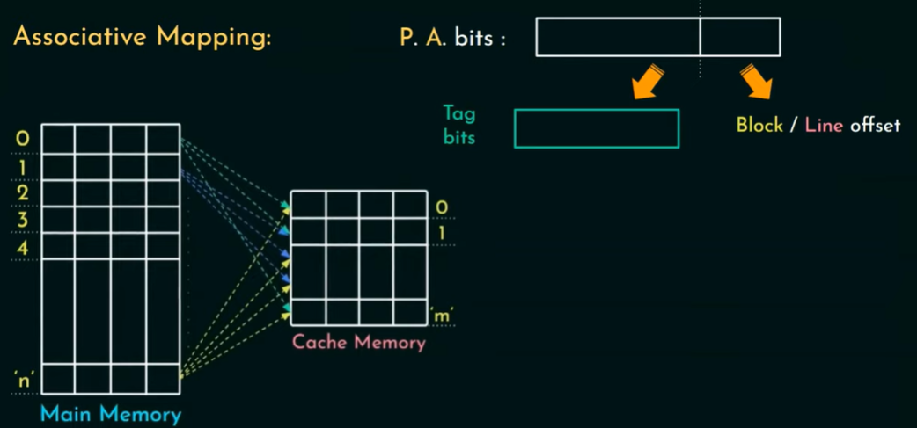

Slide 71
Hardware Implementation
A six bit comparator is used with each of the cache line
Data is fed parallel to all the comparators
And all of these are connected to a multi input OR Gate
If OR Gate produces one:
Indication that the desired block is present in one of the cache lines

Slide 72
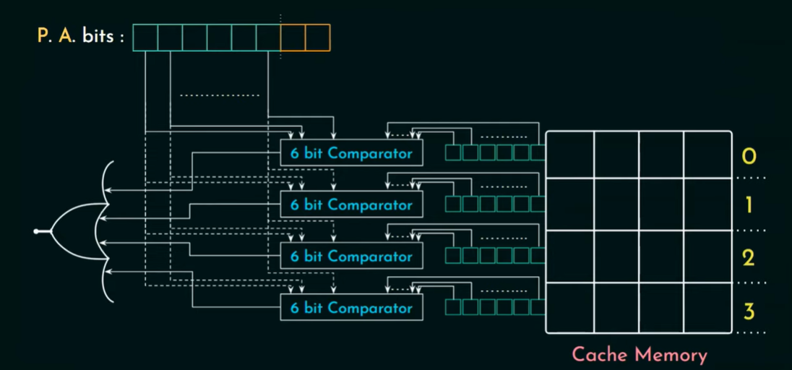


Slide 73
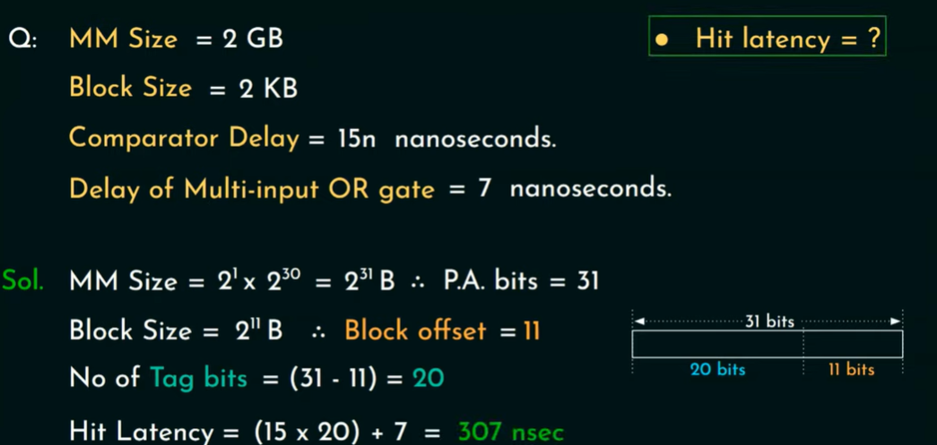

Slide 74
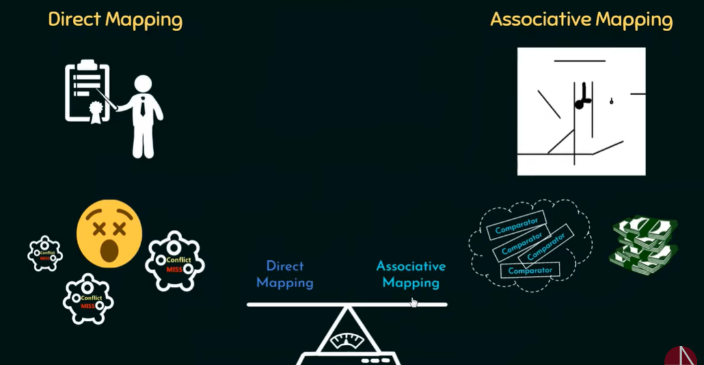

Slide 75
Set Associative
Cache memory is organized into equal sized sets
Each set has k lines
Any of the memory block can be mapped to any of lines in a particular set, like direct mapping:
Retrieval becomes easier, because we will search a particular set, rather the whole cache
Cost is reduced:
We need k comparators for each block, rather than each line

Slide 76
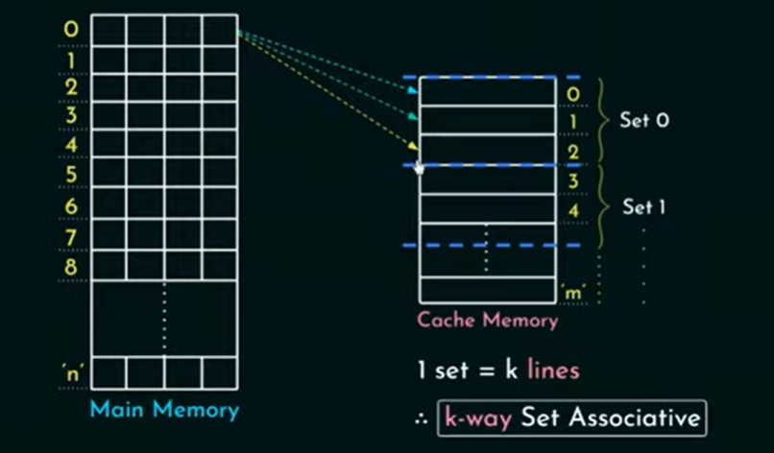

Slide 77
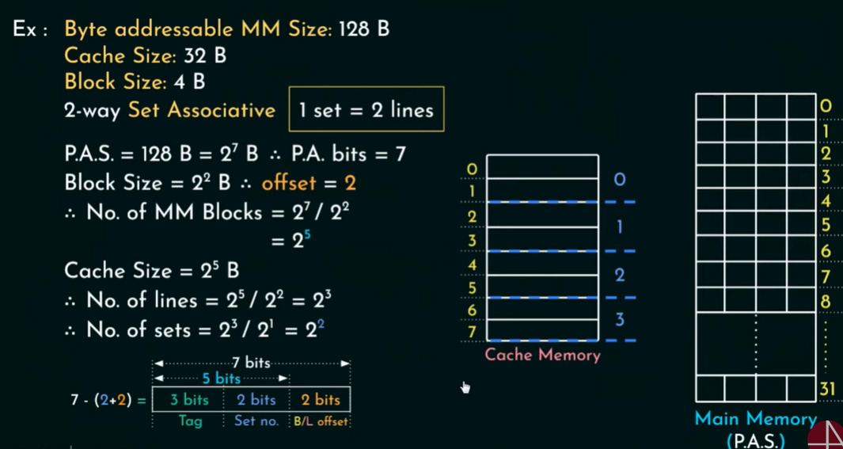

Slide 78
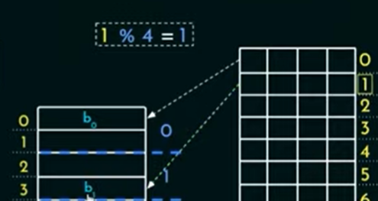
Where does a particular block resides?
What about, 4 ,5?

Slide 79
Direct | Associative | Set Associative
Main Memory Address is divided into 3 fields : TAG, BLOCK & WORD. The BLOCK & WORD together make an index. The least significant TAG bits identify a unique word within a block of main memory, the BLOCK bits specify one of the blocks and the Tag bits are the most significant bits. | Main Memory Address is divided into 1 fields : TAG & WORD. | Main Memory Address is divided into 3 fields : TAG, SET & WORD.
Advantages- Simplest type of mapping Fast as only tag field matching is required while searching for a word. It is comparatively less expensive than associative mapping. | Advantages- It is fast. Easy to implement | Advantages- It gives better performance than the direct and associative mapping techniques.

Slide 80
Direct | Associative | Set Associative
Disadvantages- It gives low performance because of the replacement for data-tag value. | Disadvantages- Expensive because it needs to store address along with the data. | Disadvantages- It is most expensive as with the increase in set size cost also increases.

Slide 81
Replacement Algorithms
Lets assume, cache is completely filled:
When a new block is brought in the cache:
Existing block must be replaced
Hence, there is a need of Replacement Algorithms

Slide 82
Replacement Algorithms
LRU(Least Recently Used):
Replace the block in cache, residing longest with no reference
It is implemented with the help of a USE Bit

Slide 83
Replacement Algorithms
FIFO(First in First Out):
Replace that block in cache, that’s been longest in the cache, that means which arrived first in the cache
FIFO is easily implemented as a round robin technique

Slide 84
Replacement Algorithms
LFU (Least frequently Used):
Replace that block in cache, that has experienced fewest references from the memory
Implemented by associating a counter with each line

Slide 85
Write Policy
When a block is to be replaced:
If no changes have been made to the block:
Override with the new block
If even a single change has been made:
Main Memory must be updated about that

Slide 86
Write Policy
The simplest technique in write policy is:
Write Through:
All write operations are made to main memory as well as cache
Main memory is always valid
Major disadvantage is memory traffic

Slide 87
Write Policy
Write Back:
Updates are only made in cache, when updates are made:
Dirty bit, associated with the cache line is set to 1
When a block is replaced:
Dirty bit is checked
If 1, written back to memory, otherwise not

Slide 88
Line size
8 to 64 bytes seem optimum
For High performance systems:
64 and 128 bytes cache line sizes are used

Slide 89
Number of caches
Multilevel Caches:
Increase in logic density: on chip caches
Reduce external bus activity, hence increases performance
Also called an internal cache (L1)
Why external cache then?
If data is not found in L1?
The processor will have to visit the memory, which results in slower access time
With increased density, contemporary processors have on-board, L2 and L3 caches now

Slide 90
Unified vs Split Caches
Unified Cache:
Both instruction and data are stored in same cache
Split Cache:
Instruction and data are stored in separate caches
Exp: L1 Instruction cache, and L1 Data Cache

